Slide 1
Module 1 Introduction to Computer Architecture and Organization

Slide 2
1.1 Introduction
Computer Architecture:
It refers to those attributes of a system which are visible to the programmer, or in other words, those attributes that have a direct impact on the logical execution of a program.
Computer Organization:
It refers to the operational units and their interconnections that realize the architectural specifications.

Slide 3
Examples of architecture attributes include the instruction set, the number of bits to represent various data types (e.g.., numbers, and characters), I/O mechanisms, and technique for addressing memory.
Examples of organization attributes include those hardware details transparent to the programmer, such as control signals, interfaces between the computer and peripherals, and the memory technology used.

Slide 4
It is an architectural design issue whether a computer will have a multiply instruction.
It is an organizational issue whether that instruction will be implemented by a special multiply unit or by a mechanism that makes repeated use of the add unit of the system.
The organization decision may be based on the anticipated frequency of use of the multiply instruction, the relative speed of the two approaches, and the cost and physical size of a special multiply unit.
Many computer manufacturers offer a family of computer model, all with the same architecture but with differences in organization. Consequently, the different models in the family have different price and performance characteristics.
Furthermore, an architecture may survive many years, but its organization changes with changing technology.

Slide 5
Example - IBM System/370 architecture
This architecture was first introduced in 1970 and included several models. The customer with modest requirements could buy a cheaper, slower model and, if demand increased, later upgrade to a more expensive, faster model without having to abandon software that had already been developed.
Over the years, IBM has introduced many new models with improved technology to replace older models, offering the customer greater speed, lower cost, or both.
These newer models retained the same architecture so that the customer’s software investment was protected. Remarkably, the System/370 architecture, with a few enhancements, has survived to this day as the architecture of IBM’s mainframe product line.

Slide 6
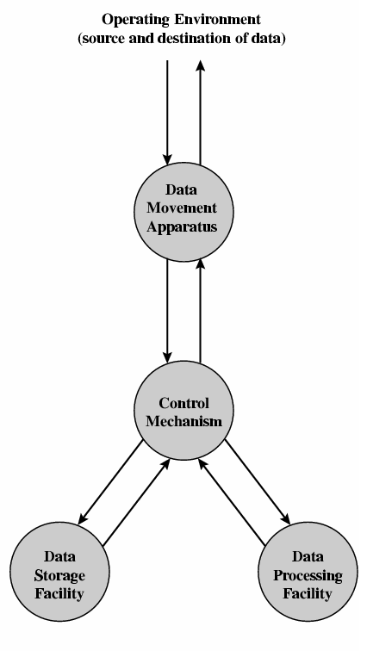
1.2.1 Function
In general terms, there are four main functions of a computer:
Data processing
Data storage
Data movement
Control
Figure 1.1 A functional view of the computer

Slide 7
The computer, of course, must be able to process data. The data may take a wide variety of forms, and the range of processing requirements is broad. However, we shall see that there are only a few fundamental methods or types of data processing.
It is also essential that a computer stores data. Even if the computer is processing data on the fly (i.e., data come in and get processed, and the results go out immediately), the computer must temporarily store at least those pieces of data that are being worked on at any given moment. Thus, there is at least a short-term data storage function.
The computer must be able to move data between itself and the outside world. The computer’s operating environment consists of devices that serve as either sources or destinations of data. When data are received from or delivered to a device that is directly connected to the computer, the process is known as input-output (I/O), and the device is referred to as a peripheral. When data are moved over longer distances, to or from a remote device, the process is known as data communications.

Slide 8
Finally, there must be control of these three functions. Ultimately, this control is exercised by the individual who provides the computer with instructions. Within the computer system, a control unit manages the computer’s resources and orchestrates the performance of its functional parts in response to those instructions.

Slide 9
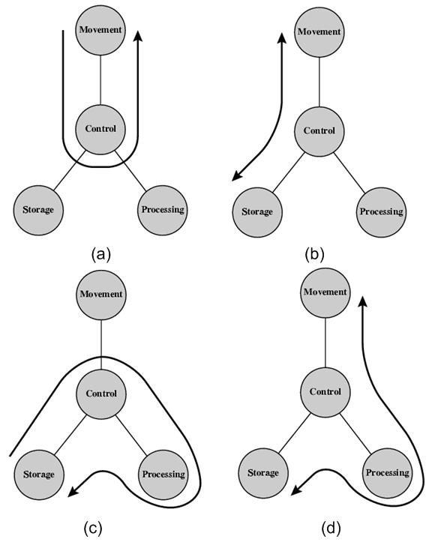
Figure 1.2 Possible computer operations

Slide 10
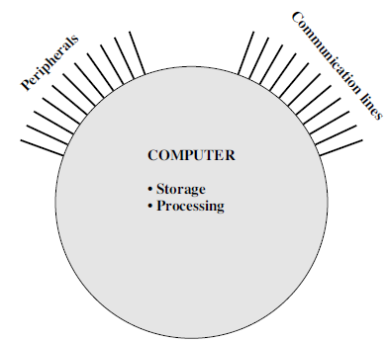
1.2.2 STRUCTURE
Figure 1.3 is the simplest possible depiction of a computer.
The computer is an entity that interacts in some fashion with its external environment.
In general, all of its linkages to the external environment can be classified as peripheral devices or communication lines.
Figure 1.3: The Computer: top-level structure

Slide 11
But of greater concern is the internal structure of the computer itself, which is shown in Figure 1.4. There are four main structural components:
Central Processing Unit (CPU): Controls the operation of the computer and performs its data processing functions. Often simply referred to as processor.
Main Memory: Stores data.
I/O: Moves data between the computer and its external environment.
System Interconnection: Some mechanism that provides for communication among CPU, main memory, and I/O.

Slide 12
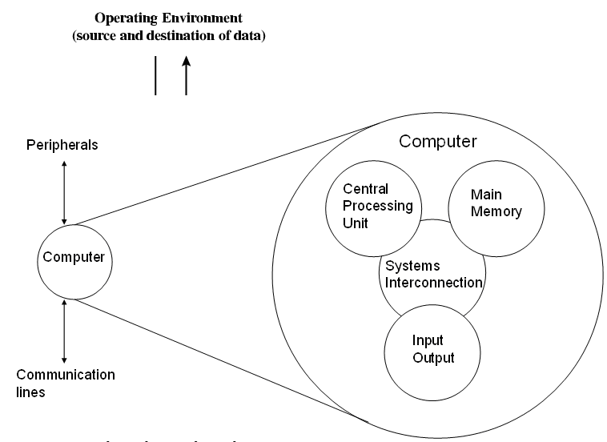
Figure 1.4: The computer: top-level structure

Slide 13
There may be one or more of each of the above components. Traditionally, there has been just a single CPU. However, in recent years, there has been increasing use of multiple processors, in a single system.
For our purpose, the most interesting and in some ways the most complex component is the CPU; its structure is depicted in Figure 1.5.
Its major structural components are as follows:
Control Unit (CU): Controls the operation of the CPU and hence the computer.
Arithmetic and Logic Unit (ALU): Performs computer’s data processing functions.
Register: Provides storage internal to the CPU.
CPU Interconnection: Some mechanism that provides for communication among the control unit, ALU, and register.

Slide 14
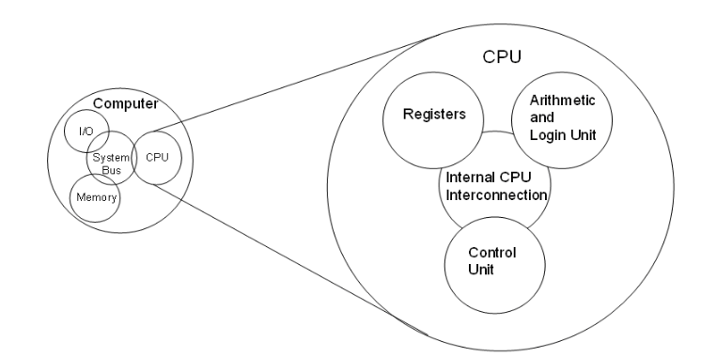
Figure 1.5: The CPU

Slide 15
The Control Unit further comprises of
Control Memory
Control Unit Register
Sequencing Logic.
The Control Memory stores the microinstructions, loads it into the control unit register and the sequencing logic gives these signals in a proper sequence to execute an instruction.

Slide 16
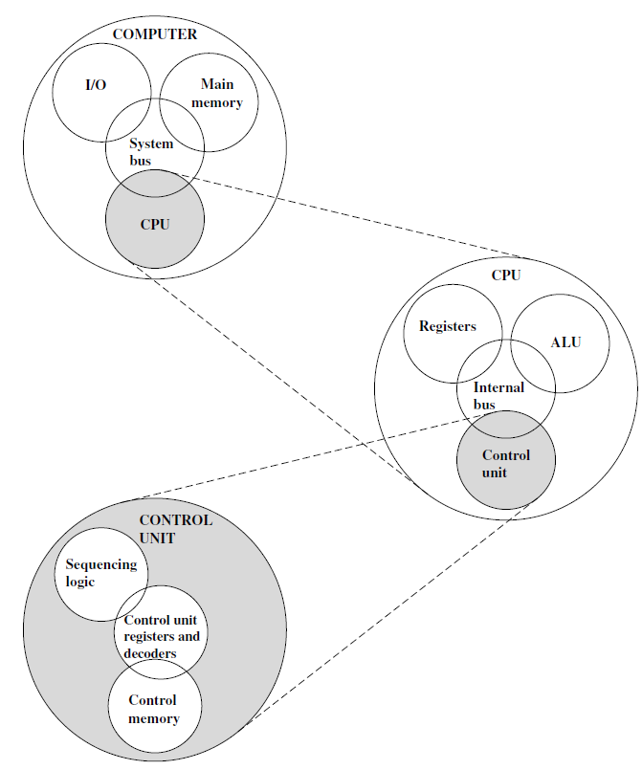
Figure 1.6: The Control Unit

Slide 17
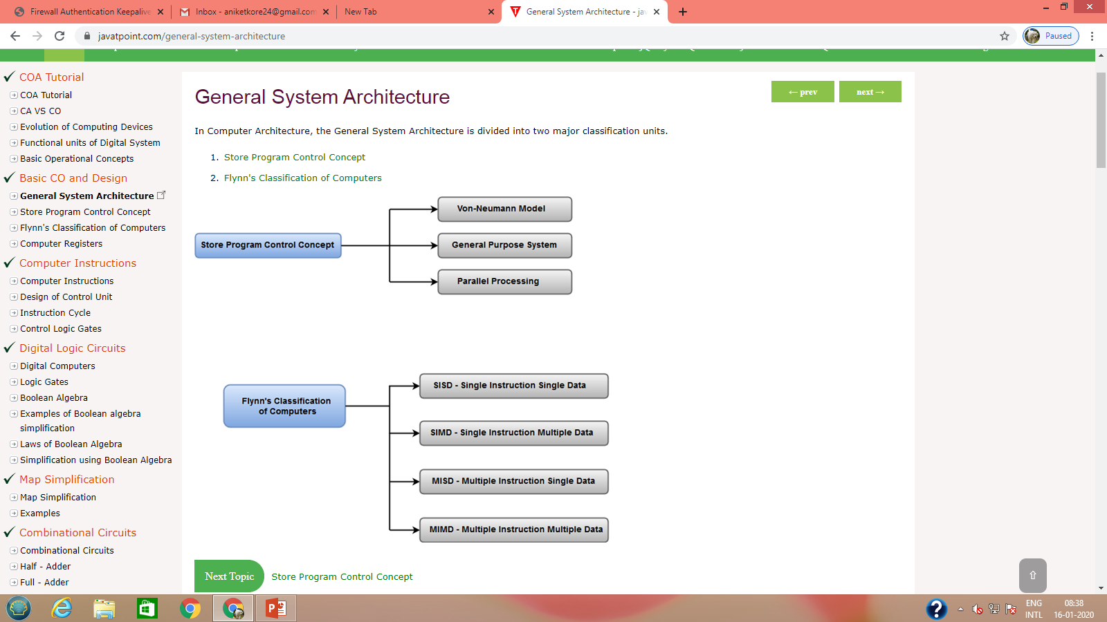

Slide 18
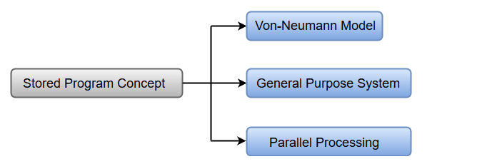
The term Stored Program Control Concept refers to the storage of instructions in computer memory to enable it to perform a variety of tasks in sequence or intermittently.
John von Neumann proposed that a program be electronically stored in the binary-number format in a memory device so that instructions could be modified by the computer as determined by intermediate computational results.

Slide 19
Von Numen Model
It consists of a CU, ALU, Memory Unit, Registers & Inputs/Outputs.
Von Neumann architecture is based on the stored-program computer concept, where instruction data and program data are stored in the same memory.
Since instructions and data both are stored in the same memory, so same buses are used to fetch instructions and data. This means the CPU cannot do both things together (read the instruction and read/write data).
Features of Von Numen System:
Uses a single processor
Uses one memory for both instructions and data.
Executes programs following the fetch-decode-execute cycle

Slide 20
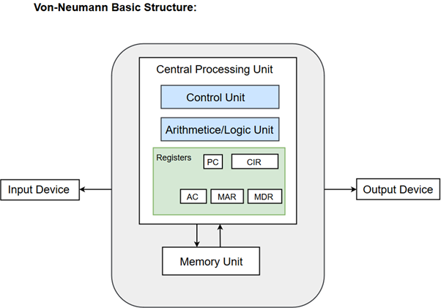

Slide 21
CU: Fetching next instructions and executing them.
ALU: Arithmetic operations.
Registers: Registers refer to high-speed storage areas in the CPU. The data processed by the CPU are fetched from the registers.
Registers | Description
MAR (Memory Address Register) | This register holds the memory location of the data that needs to be accessed.
MDR (Memory Data Register) | This register holds the data that is being transferred to or from memory.
AC (Accumulator) | This register holds the intermediate arithmetic and logic results.
PC (Program Counter) | This register contains the address of the next instruction to be executed.
CIR (Current Instruction Register) | This register contains the current instruction during processing.

Slide 22
Parallel Processing
Parallel processing can be described as a class of techniques which enables the system to achieve simultaneous data-processing tasks to increase the computational speed of a computer system.
The primary purpose of parallel processing is to enhance the computers processing capability and increase its throughput, i.e. the amount of processing that can be accomplished during a given interval of time.
A parallel processing system can be achieved by having a multiplicity of functional units that perform identical or different operations simultaneously. The data can be distributed among various multiple functional units.

Slide 23
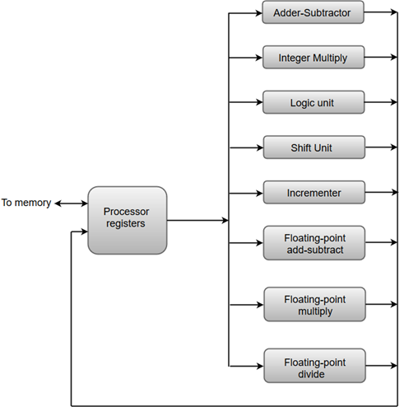
The adder and integer multiplier performs the arithmetic operation with integer numbers.
The floating-point operations are separated into three circuits operating in parallel.
The logic, shift, and increment operations can be performed concurrently on different data.
All units are independent of each other, so one number can be shifted while another number is being incremented.

Slide 24
Harvard Architecture
Harvard Architecture is the computer architecture that contains separate storage and separate buses (signal path) for instruction and data.
It was basically developed to overcome the bottleneck of Von Neumann Architecture.
The main advantage of having separate buses for instruction and data is that the CPU can access instructions and read/write data at the same time.

Slide 25
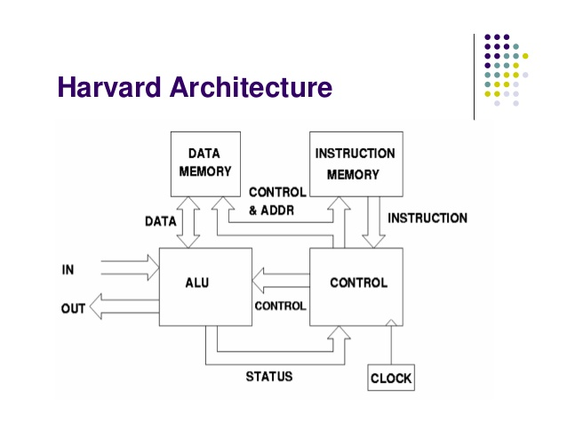

Slide 26
Data Representation and Arithmetic Algorithms

Slide 28
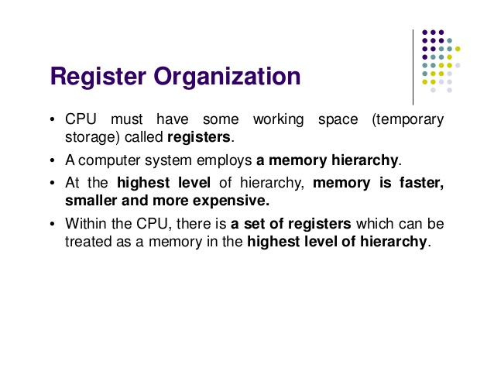

Slide 29
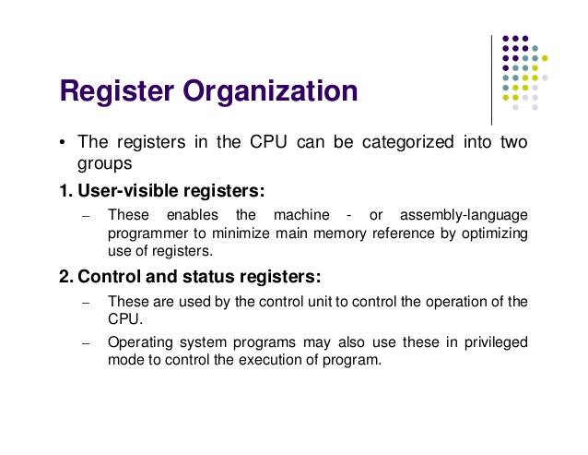

Slide 30
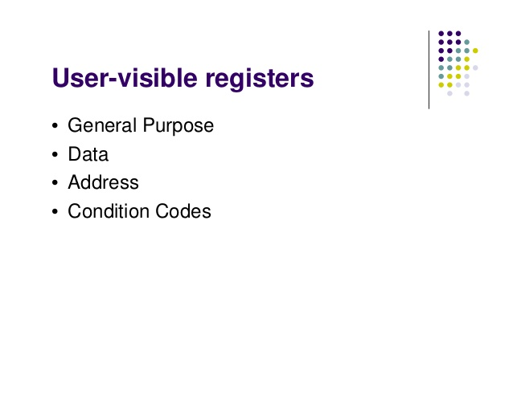

Slide 31
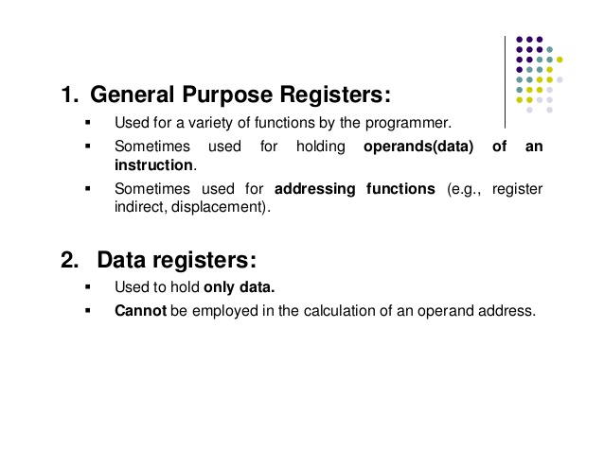

Slide 32
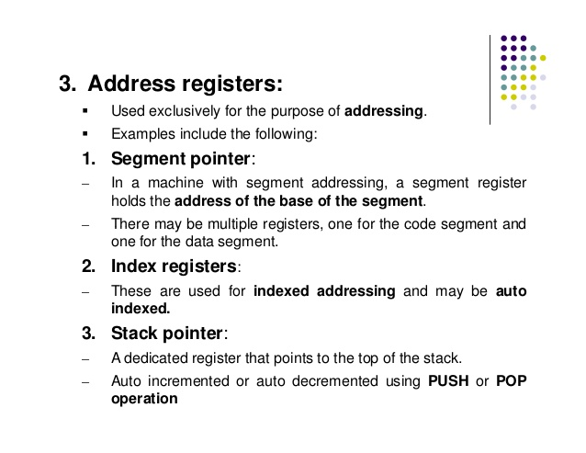

Slide 33
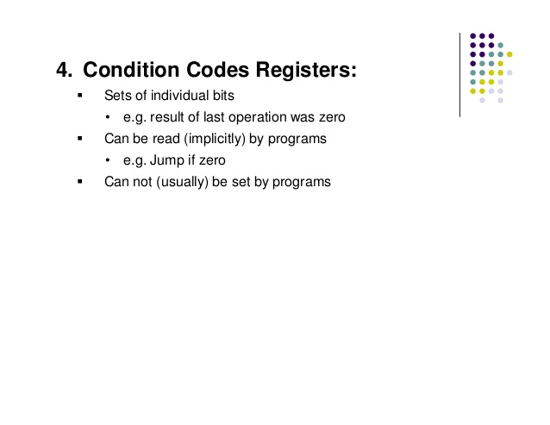

Slide 34
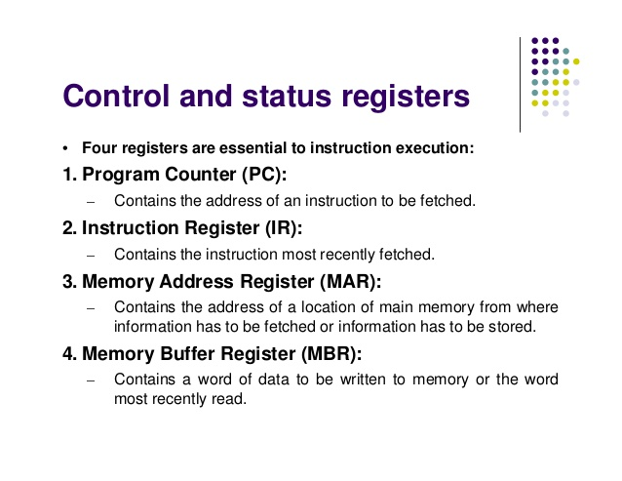

Slide 35
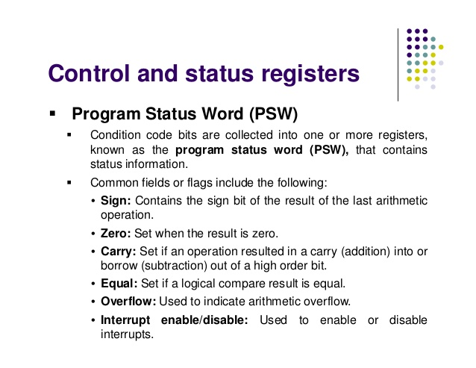

Slide 36
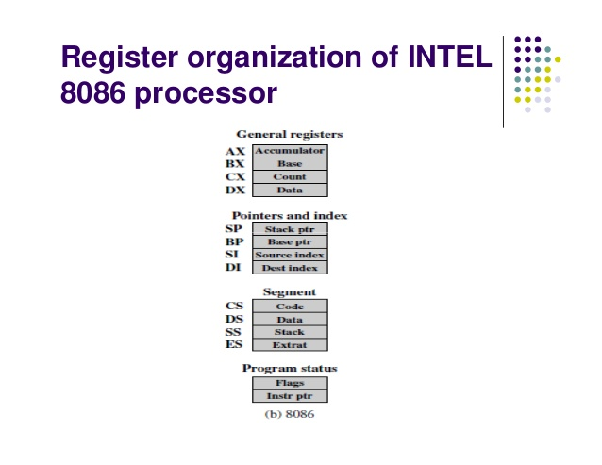

Slide 37
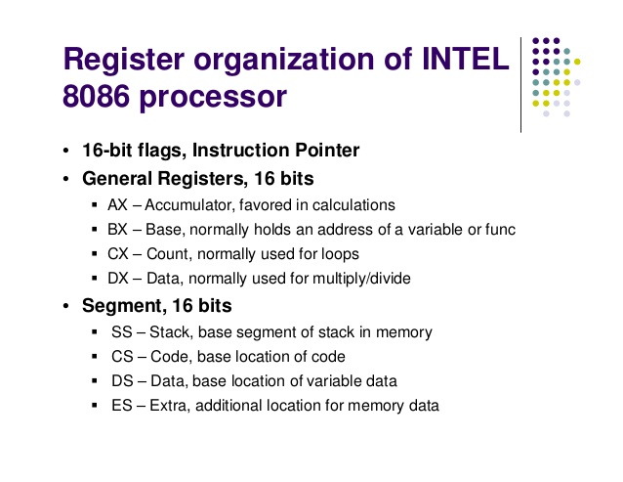

Slide 38
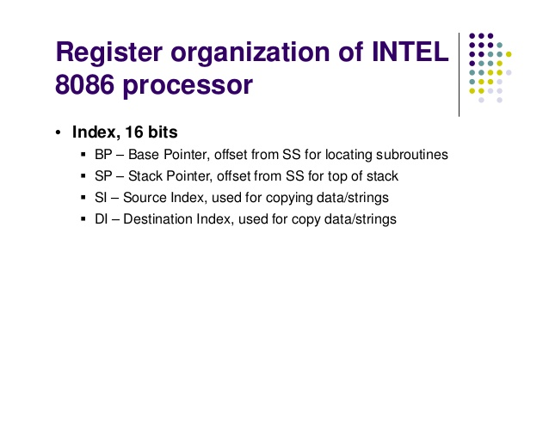

Slide 39
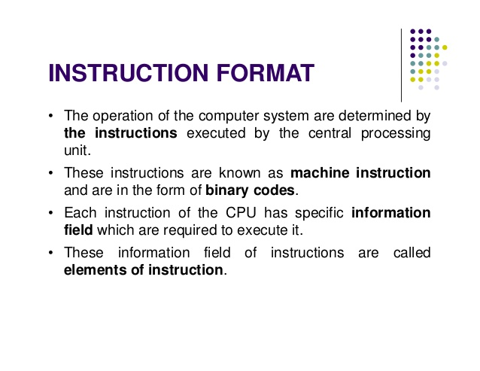

Slide 40
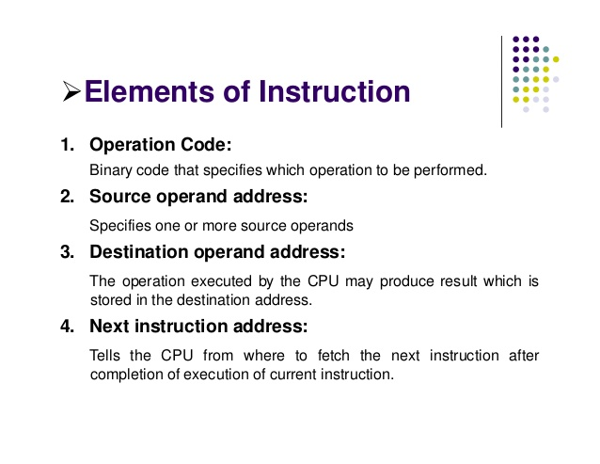

Slide 41
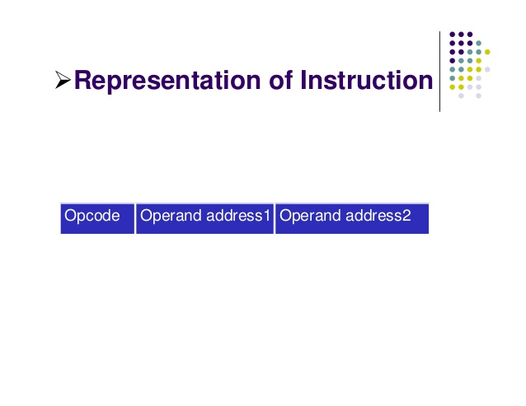

Slide 42
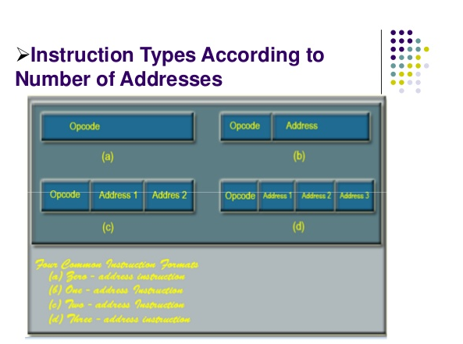

Slide 43
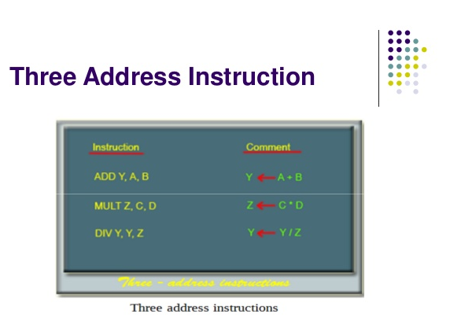

Slide 44
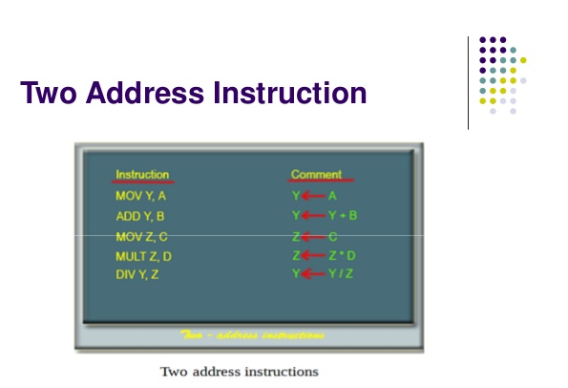

Slide 45
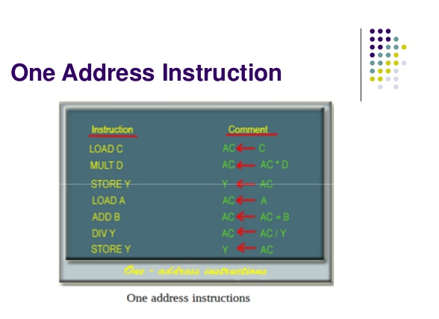

Slide 46
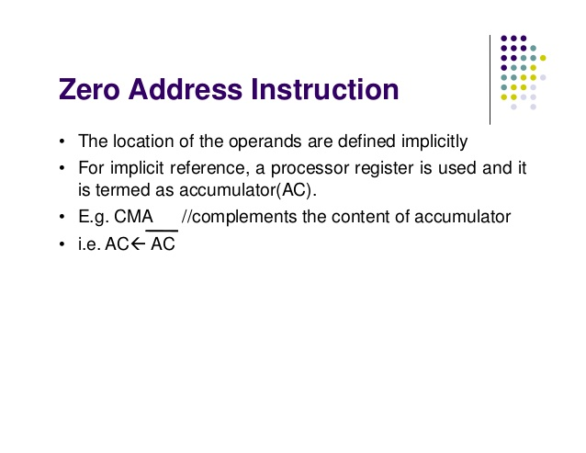

Slide 47
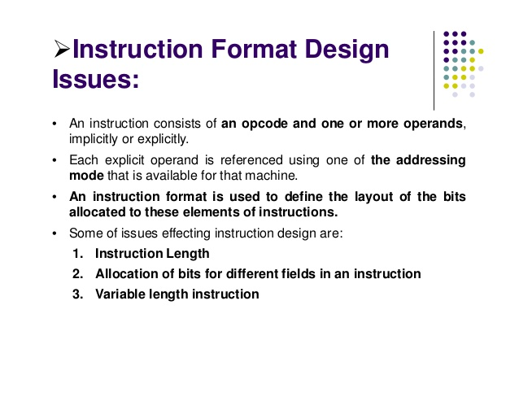

Slide 48
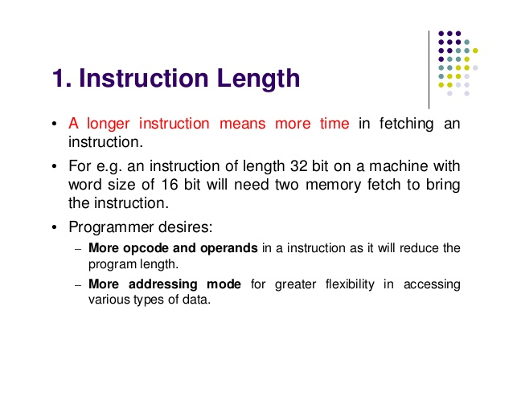

Slide 49
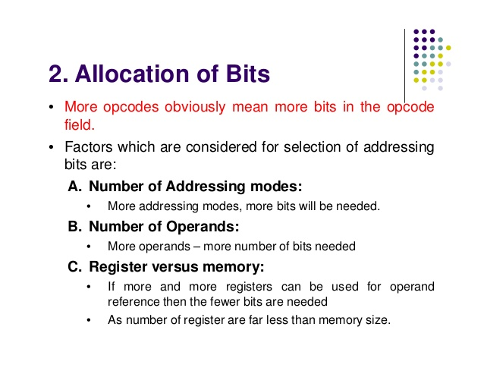

Slide 50
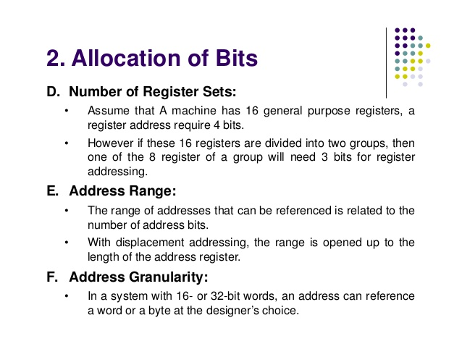

Slide 51
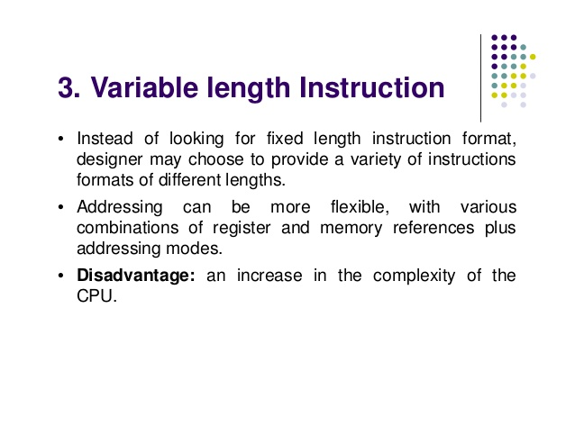

Slide 52
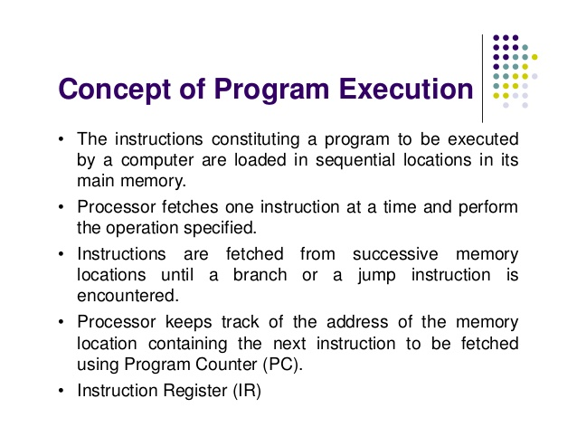

Slide 53
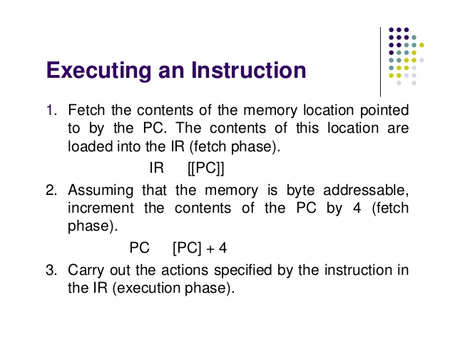

Slide 54
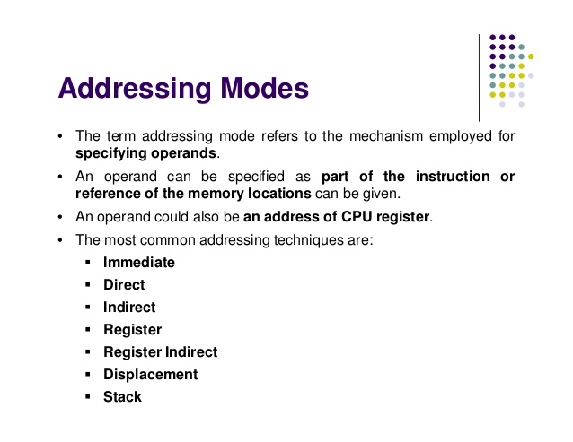

Slide 55
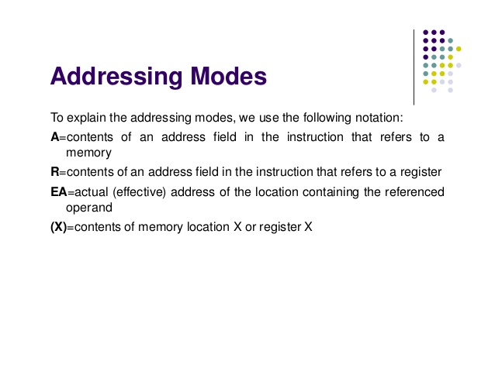

Slide 56
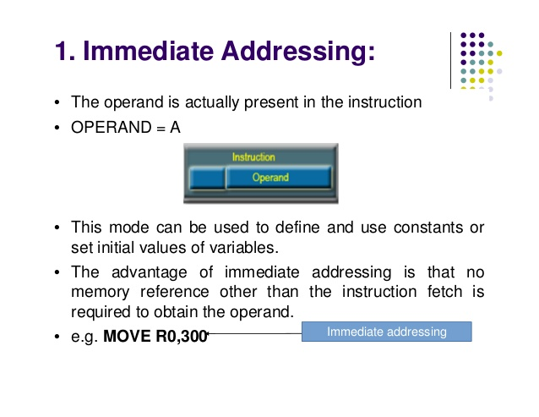

Slide 57
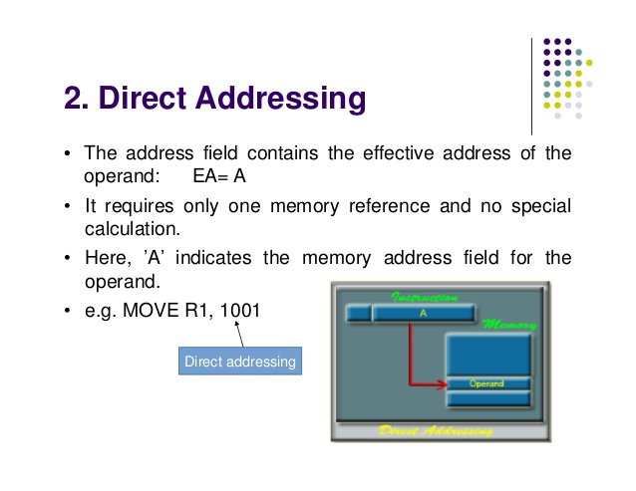

Slide 58
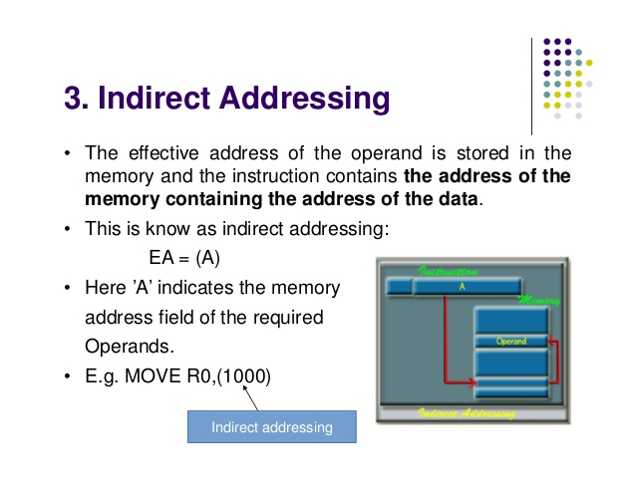

Slide 59
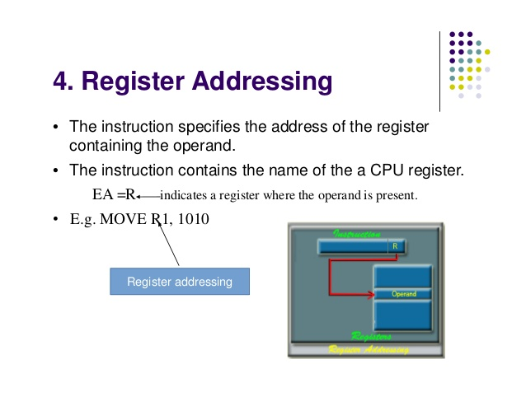

Slide 60
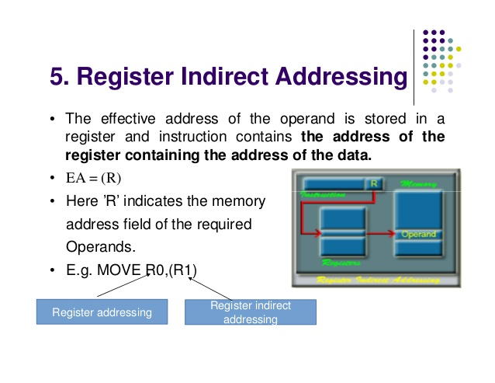

Slide 61
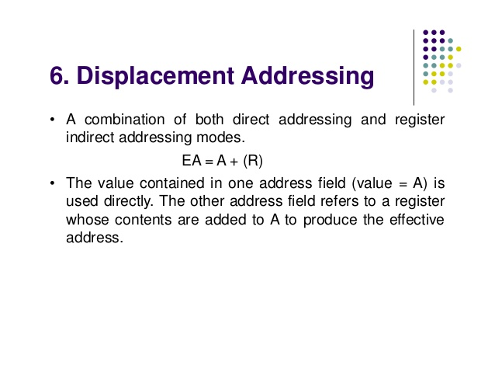

Slide 62
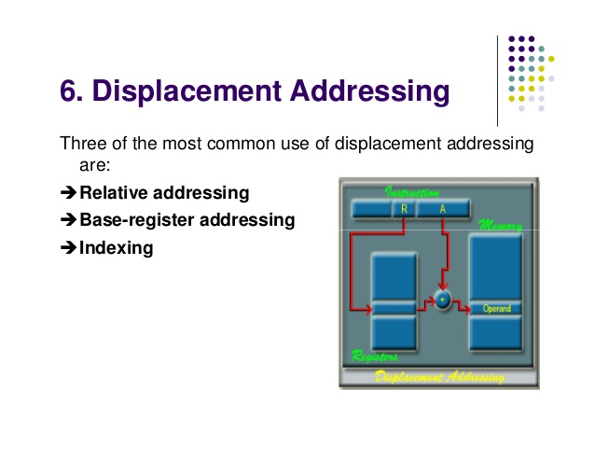

Slide 63
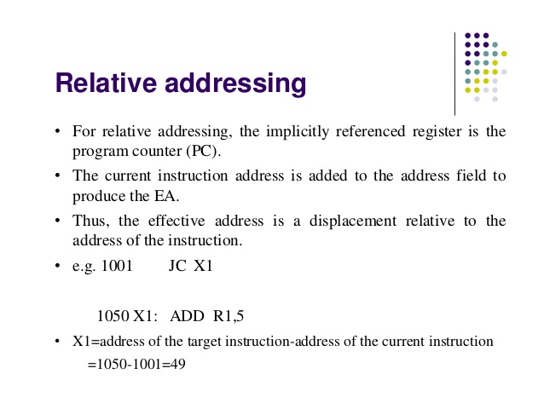

Slide 64
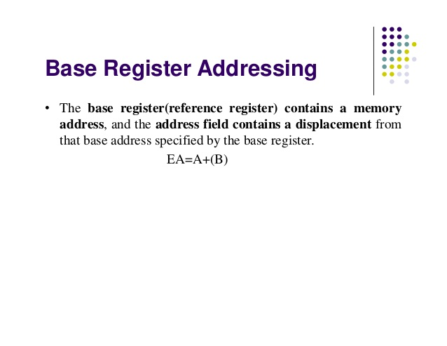

Slide 65
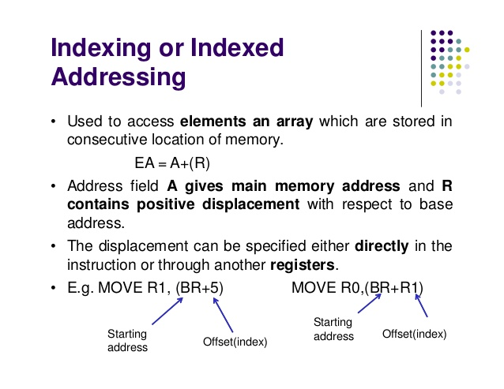

Slide 66
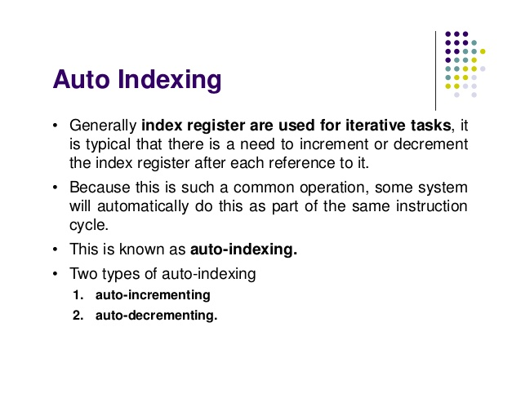

Slide 67


Slide 68


Slide 69


Slide 70


Slide 71


Slide 72


Slide 73


Slide 74


Slide 75



Slide 76


Slide 77


Slide 78


Slide 79


Slide 80


Slide 81


Slide 82


Slide 83


Slide 84


Slide 85


Slide 86


Slide 87


Slide 88


Slide 89


Slide 90


Slide 91


Slide 92
Structural Hazard (Resource conflict):
A resource hazard occurs when 2 or more instructions that are already in the pipeline need the same resources.
eg: x=y+z
The instructions required to perform this operation are:
R1←y
R2←R1+z
X←R2
(Diagram - self)

Slide 93
Data Hazard :
A data hazard occurs when an instruction depends upon the result from a previous instruction, but this result is not yet avail.
eg: ADD AX,BX
SUB CX,AX
(Diagram - self)
3 Types of Data hazard:
RAW
WAR
WAW

Slide 94

Control (Branch) Hazard :

Slide 95


Slide 96


Slide 97


Slide 98


Slide 99


Slide 100


Slide 101
Performance Measures
Clock Speed/Rate
MIPS: Million instruction per second
Speedup
Efficiency
Throughput Rate
Amdahl’s Law

Slide 102

Therefore, T=IC*CPI*t
Where T= Total time req by the prog,
IC=No. of instructions
CPI= Cycles per instruction
t= Cycle time in ns

Slide 103


Slide 104


Slide 105


Slide 106


Slide 107
Amdahl’s Law

Slide 108
END

